Slide 1
Welcome to: AmeriCorps VIP Supervisor Training

Slide 2
Agenda
Introductions
About Volunteer Infrastructure Project
About AmeriCorps
Timeline
Member Expectations and Management
Reporting and Monitoring
Q&A

Slide 3
Contact
Christina Thurston
connect@scvolunteercenter.org
(831) 427-5070 ext. 117

Slide 4
Introducing: vip Partner Sites
Volunteer Center
Lead
Community Engagement
Helping Hands Senior Home Repair
Digital NEST
Watsonville
Santa Cruz
Ecology Action
The Diversity Center
Young Writer’s Program
UCSC Arboretum
Victim Witness Program
Homeless Services Center
Notes:
Blue=New to program
Red=New Supervisor

Slide 5
VIP aims to help you do more.
We build and strengthen volunteer programs within nonprofit and educational organizations that improve the lives of children and families.

Slide 6
Our Goals:
Partner Sites will achieve a new standard in effective volunteer programming
Each Partner Site will gain 80 one-time and 40 High Value/long-term volunteers
Each Partner Site will garner $2,000 through the AmeriCorps member’s fundraising
AmeriCorps members will grow in professional skills by 20 %

Slide 7
Terms
NCOE = Napa County Office of Education
CalSERVES = AmeriCorps programs run through NCOECP
Supervising Organization=The Volunteer Center of Santa Cruz County
Partner Site=Your organization!

Slide 8
Corporation for National and Community Service (CNCS)
AmeriCorps
Other CNCS programs include:
Senior Service Corps
SIF
Volunteer Generation Fund
VIP is the LARGEST capacity-building AmeriCorps State program in the country.
VISTA
State & National Programs
NCCC
California Volunteers
CalSERVES Volunteer Programs – including VIP and CalPREP
VIP Supervising Organizations
VIP Partner Site Programs

Slide 9
How do we make it All happen?
AmeriCorps!
https://www.youtube.com/watch?v=3qw_aq-KiJw&list=UU1VuXCdPlovso1vcqi2dMng
Notes:
Americorps Background
In 1993, President Bill Clinton signed the National and Community Service Trust Act, which established the Corporation for National and Community Service and brought the full range of domestic community service programs under the umbrella of one central organization.
The newly created AmeriCorps incorporated two existing national service programs: the longstanding VISTA (Volunteers in Service to America) program, created by President Lyndon Johnson in 1964 and the National Civilian Community Corps (NCCC).
More than 330,000 individuals have served through AmeriCorps.
During the past decade, more than 1 billion volunteer service hours have been generated by Senior Corps volunteers.
More than 1.8 billion high school students participate annually in service-learning initiatives funded by Learn and Serve America.

Slide 10
AmeriCorps members:
Commit 1700 hours to the AmeriCorps Program and are assigned to perform service at Partner Sites.
http://youtu.be/_Y8vb0iRaPA

Slide 11
What our members do:
765 hours (45% of their service):
Building infrastructure/systems at the Partner Site to effectively engage volunteers and increase capacity to serve clients through volunteer programs.
595 hours (35% of their service):
Recruiting, screening, training, or placing 80 one-time and 40 long-term, High Value volunteers.
170 hours (10% of their service):
Fundraising, or garnering new resources to increase and complement the Partner Site’s service efforts through fundraising and the building of business partnerships.
170 HOURS (10% OF THEIR SERVICE):
Participating in training opportunities, including live and online trainings, team meetings, and coaching meetings with supervisors and team leaders.

Slide 12
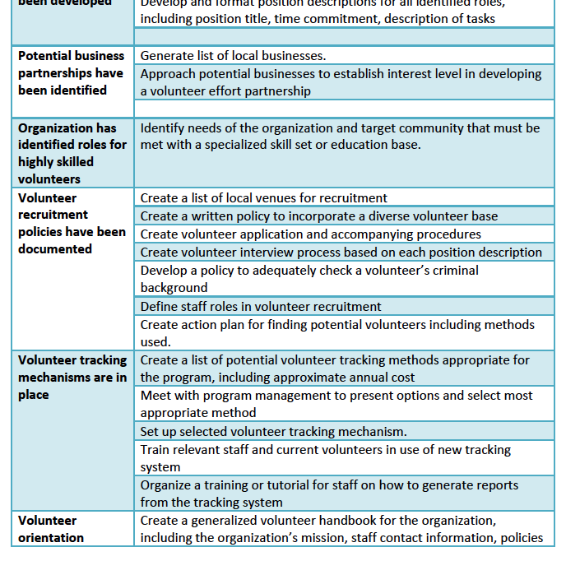
The Member Work Plan
This document guides your AmeriCorps member in their main task of building volunteer infrastructure at your organization.
Notes:
Review work plan – walk through versus VCA

Slide 13
Americorps regulations
We’re federally funded.
In addition to being responsible to heavily track (and of course meet!) our goals, we’re subject to AmeriCorps Regulations and State and Federal audits.
So, sorry for all that paperwork.

Slide 14
Americorps regulations
Regulations that affect the AmeriCorps member include:
Participation in National Days of Service
Code of Conduct and Prohibited Activities
Service hours requirement
Set service activities

Slide 15
Startup Timeline
AmeriCorps members start: 9/5/17
Orientation continues: 9/6/17
First full day at site: 9/7/16
Training Schedule
Two meetings per month
1st or 2nd Friday 9am to 11am
3rd Wednesday 11am-1pm

Slide 16
The Orientation includes:
Complete Paperwork
Intro to VIP, CalSERVES, and AmeriCorps
Volunteer Management overview and basics
Professionalism and problem-solving

Slide 17
Managing Members
Notes:
Member management is a partnership between YOU and CalSERVES

Slide 18
Partner site expectations:
Provide adequate work space for the member (computer, phone, desk)
Designate an on-site, paid staff person as the member’s supervisor
Require member to attend all AmeriCorps- and CalSERVES sponsored trainings and events
Provide 25 hours of Professional Development opportunities for the member

Slide 19
The designated Partner Site Supervisor:
Should be familiar with the organization’s volunteer program
Supervises day-to-day activities and meets regularly with the member (weekly/biweekly)
Addresses behavior concerns as they arise
Communicates with Volunteer Center
Fills out the Member Evaluation 3x/year
Fills out the VCA 3x/year
Must be background checked (all AmeriCorps staff must be background checked)

Slide 20
AmeriCorps member Expectations are in the handbook

Slide 21
Basically,
Members should be held to a high standard of service, much like anyone else on your organization’s team.

Slide 22
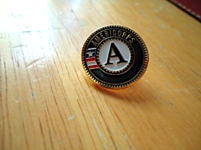
Reppin’ the “A”
AmeriCorps members must:
Wear the AmeriCorps ‘A’ at all times while earning service hours
Represent themselves as AmeriCorps members on business cards, in correspondence, etc
Notes:
Members must wear the AmeriCorps ‘A’ logo at all times when serving. They also must refer to themselves as AmeriCorps members as a part of their title. We have a few options for AmeriCorps members – but their correspondence, business cards, etc should reflect AmeriCorps

Slide 23
Absences
5 personal and 10 sick/bereavement days.
Personal days must be requested 2 weeks in advance and approved by PS.
Members must notify YOU by 8 am if they will be late or cannot serve as scheduled.
Notify Christina if the members attendance becomes an issue.

Slide 24
Disciplinary Procedure
If you notice any performance concerns, contact Christina right away.
Disciplinary Action
Informal/formal
Written warning process
Release from service

Slide 25
Any tips for supervising AmeriCorps members?

Slide 26
Reporting

Slide 27
Partner Reporting
See Partner Site calendar for due dates
Volunteer Capacity Assessment (VCA): 3x/year
Member Evaluation: 3x/year
Member Time Sheet Approval via OnCorps: every 2 weeks
Monthly Reports Approved via OnCorps

Slide 28
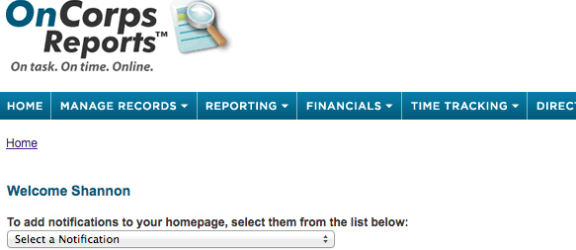
onCorps

Slide 29
VCA
If you enter a YES, it must remain a YES for future VCAs
If more than 70% YES, CalSERVES will not see a need for an AmeriCorps Member at your site.
Finished VCAs should be sent to Shannon

Slide 30
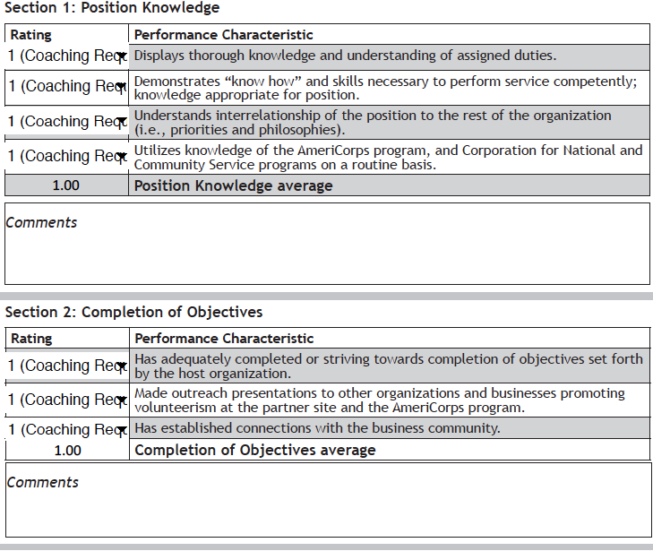
Evaluations
Must be competed with the member present
Must be signed and dated by both member and supervisor
Finished Evals should be sent to Shannon

Slide 31
Member Reporting
Member Time Sheet via OnCorps: every 2 weeks
Member Monthly Reports via OnCorps
Require volunteer tracking and donation data
Additional reporting may be required

Slide 32
Questions?

Slide 33
THANK YOU for your partnership with VIP.
Any questions?

